Slide 1
Insurance Fraud Detection using ML and Blockchain
Review - 2

Slide 2
Exploratory Data Analysis

Slide 3
EDA Observation
PotentialFraud has only two unique values
The dataset is highly imbalanced with 90.6% non-fraud Providers and 9.4% fraud Providers class label
As almost all values of this feature is having value of 12, this feature won't make any impact in doing the classification. Hence, we can drop this feature.
As almost all values of the features NoOfMonths_PartACov and NoOfMonths_PartBCov is having a value of 12, this feature won’t make any impact in doing the classification. Hence, we can drop these features.
The data is reasonably balanced for all features in Chronic Conditions except for ‘ChronicCond_Cancer’ and ‘ChronicCond_stroke’ where the data is imbalanced.

Slide 4
EDA
For IPAnnualReimbursementAmt Feature, most of the amount lies between 0 and 5000.
For IPAnnualDeductibleAmt Feature, most of the amount lies between 0 and 2000.
For OPAnnualReimbursementAmt Feature, most of the amount lies between 0 and 5000.
For OPAnnualDeductibleAmt Feature, most of the amount lies between 0 and 2000.
Rest all the amounts greater than the above ranges are outliers. In this case study, those high amount values can be the potential fraud cases. Hence, we won’t remove those outliers.

Slide 5
EDA OF INPATIENT AND OUTPATIENT
Inpatient Dataset has a total of 30 features and Outpatient Dataset has a total of 27 features.
All the 27 features of Outpatient are also present in the Inpatient Dataset.
Inpatient Dataset has 3 extra features viz., ‘AdmissionDt’, ‘DischargeDt’ and ‘DiagnosisGroupCode’.
Hence, we will merge the data from the Inpatient and Outpatient Dataset along with the common columns and do the EDA on the merged data.

Slide 6
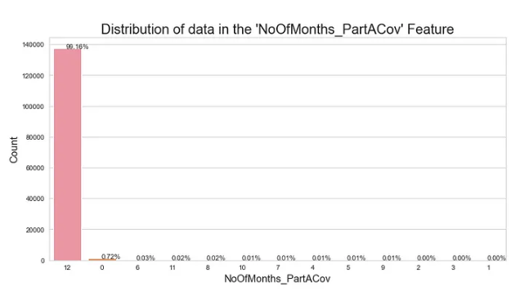

Slide 7
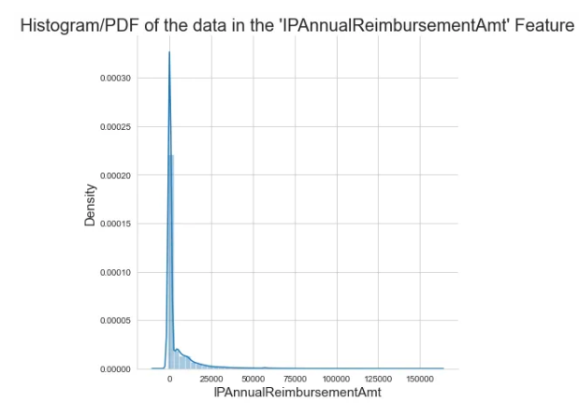

Slide 8
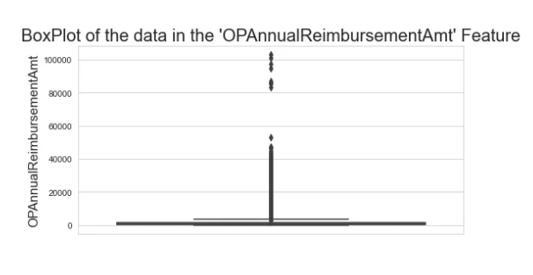

Slide 9
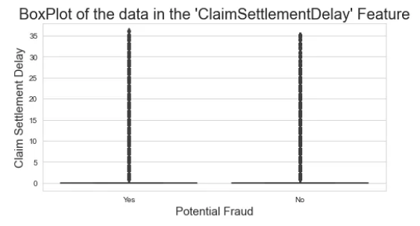

Slide 10
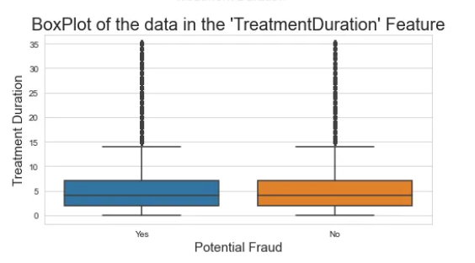

Slide 11
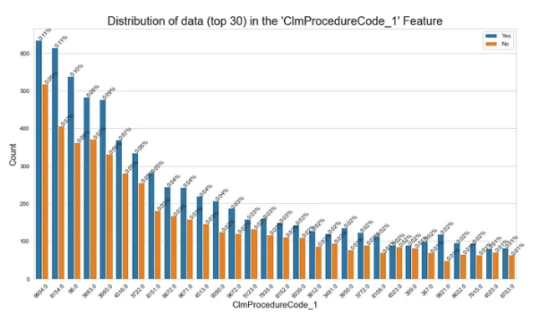

Slide 12
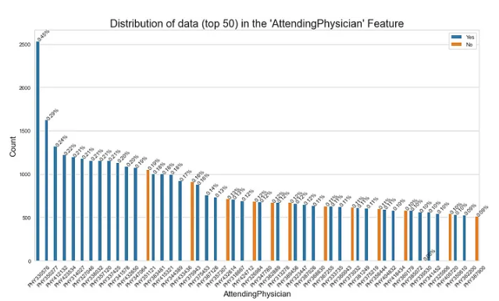

Slide 13
Feature Selection

Slide 14
Chi² Feature Selection
Chi-squared (χ²) feature selection is a statistical technique for identifying and selecting essential features from a dataset, particularly in scenarios with categorical or discrete data. It assesses the independence between each feature and a target variable, generating contingency tables to capture the associations. By calculating chi-squared statistics based on observed and expected counts in these tables, the method quantifies the significance of these relationships. Features with higher chi-squared scores, indicating strong associations, are prioritized for inclusion in predictive models. This technique is valuable for dimensionality reduction, improving model interpretability, and enhancing classification accuracy, making it especially useful when dealing with datasets featuring numerous categorical variables.

Slide 15
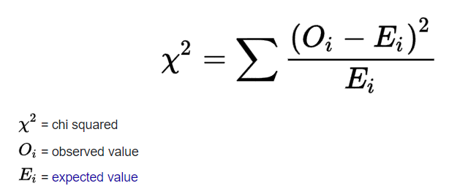
Chi² Feature Selection

Slide 16
Libraries Used
import pandas as pd:
Pandas is used for several tasks:
Loading and representing data from various sources
Merging data from different DataFrames using pd.merge()
Creating contingency tables using pd.crosstab() to analyze the relationships between categorical variables.
import scipy.stats: SciPy is used primarily for statistical analysis, specifically for performing chi-squared tests using scipy.stats.chi2_contingency(). The chi-squared test is used to determine the independence or association between two categorical variables in a contingency table.

Slide 17
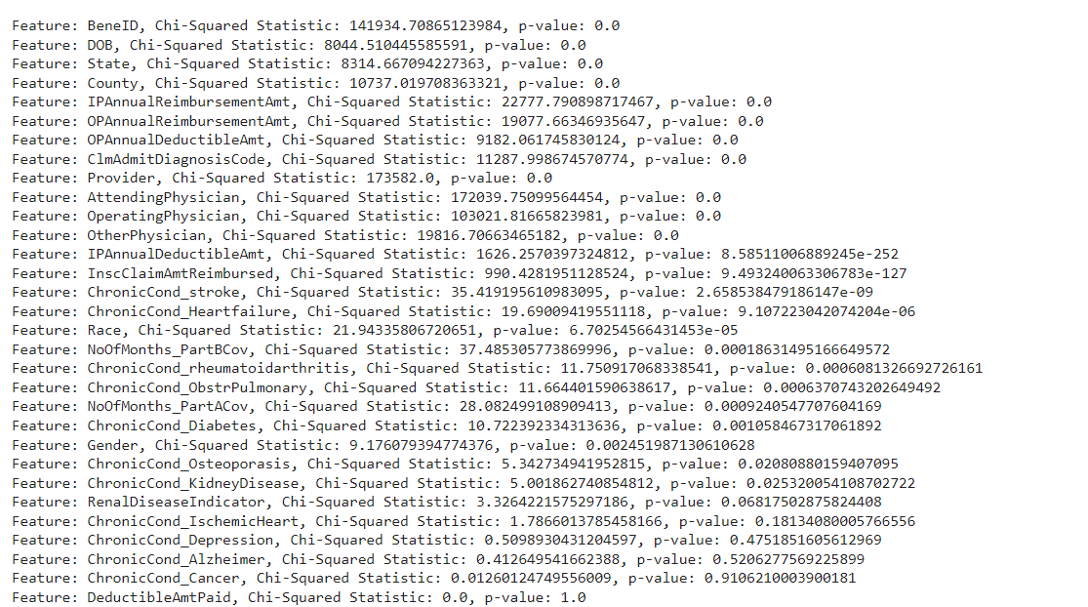
The above screenshot gives out the potential p-value for all the features to our target value . The closer the value to 0 is highly associated with the target value and closer to 1 , the value is less associated with the target value.

Slide 18
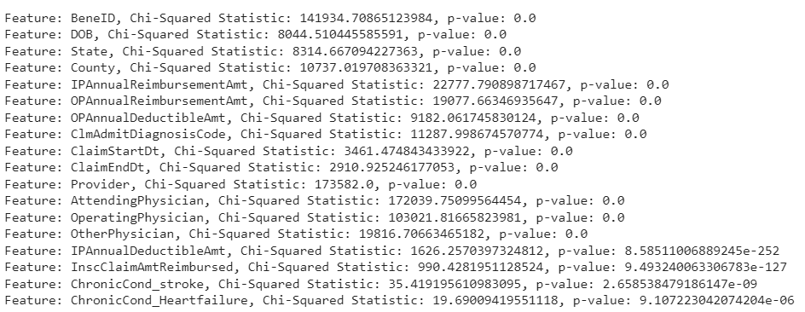
These are the those features whose p-value is lesser than the assumed alpha value- 0.00001. So these features are highly associated with the target variable than the rest

Slide 19
Decision Tree

Slide 20
Libraries Used
Pandas
NumPy
Seaborn
Matplotlib
Scikit-Learn (sklearn)
RandomizedSearchCV
StandardScaler
DecisionTreeClassifier
train_test_split

Slide 21
Data Preprocessing
Data Cleanup
Data Processing
Feature Engineering
Data Splitting

Slide 22
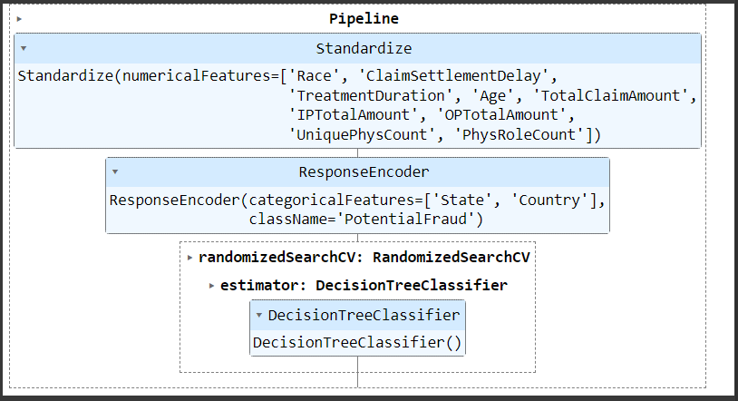
Decision Tree Classifier

Slide 23
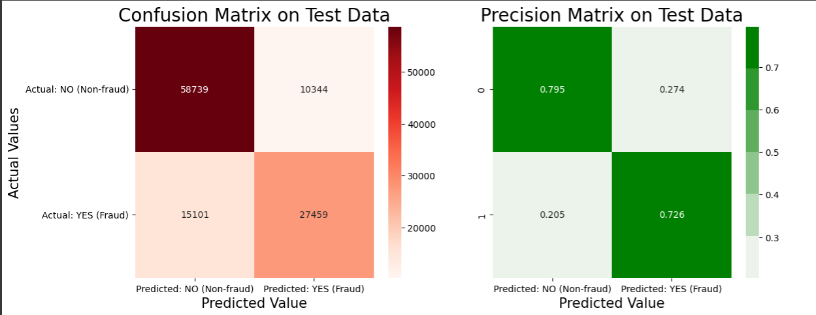
Performance Metrics

Slide 24
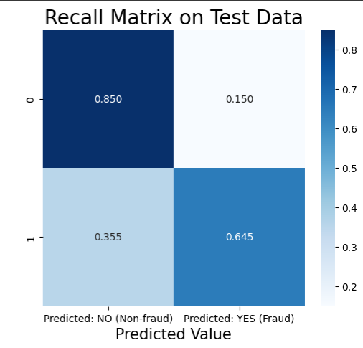
Performance Metrics

Slide 25
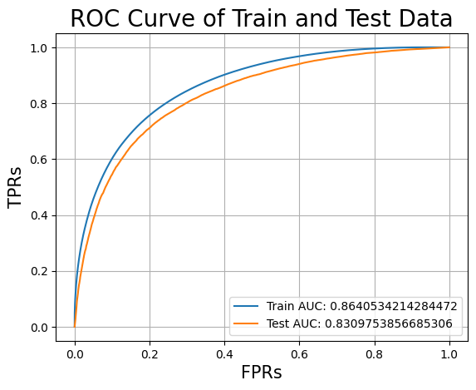
Performance Metrics

Slide 26
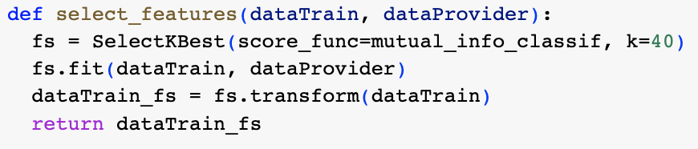
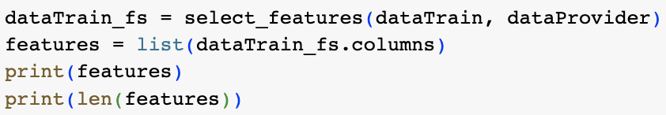
Mutual Information

Slide 27
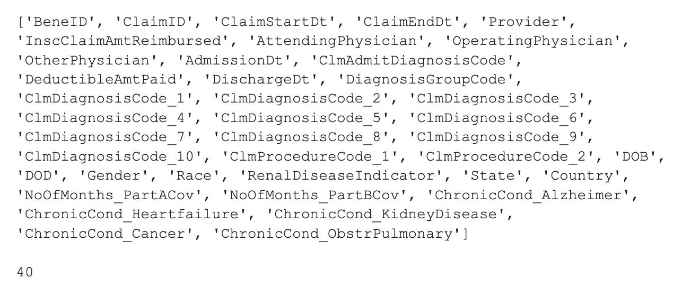

Slide 28
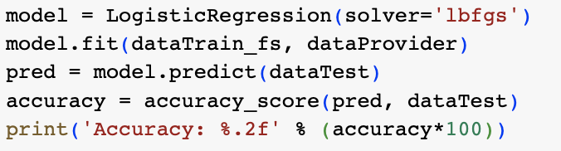


Slide 29
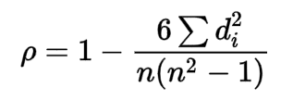
Spearman's rank correlation coefficient
Spearman's rank correlation coefficient or Spearman's ρ, is a nonparametric measure of rank correlation. It assesses how well the relationship between two variables can be described using a monotonic function.
The Spearman correlation between two variables is equal to the Pearson correlation between the rank values of those two variables; while Pearson's correlation assesses linear relationships, Spearman's correlation assesses monotonic relationships (whether linear or not).

Slide 30
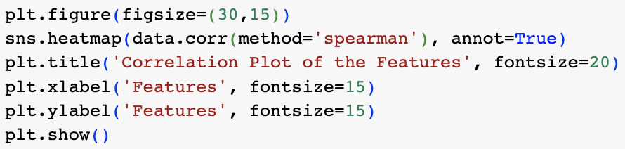

Slide 31
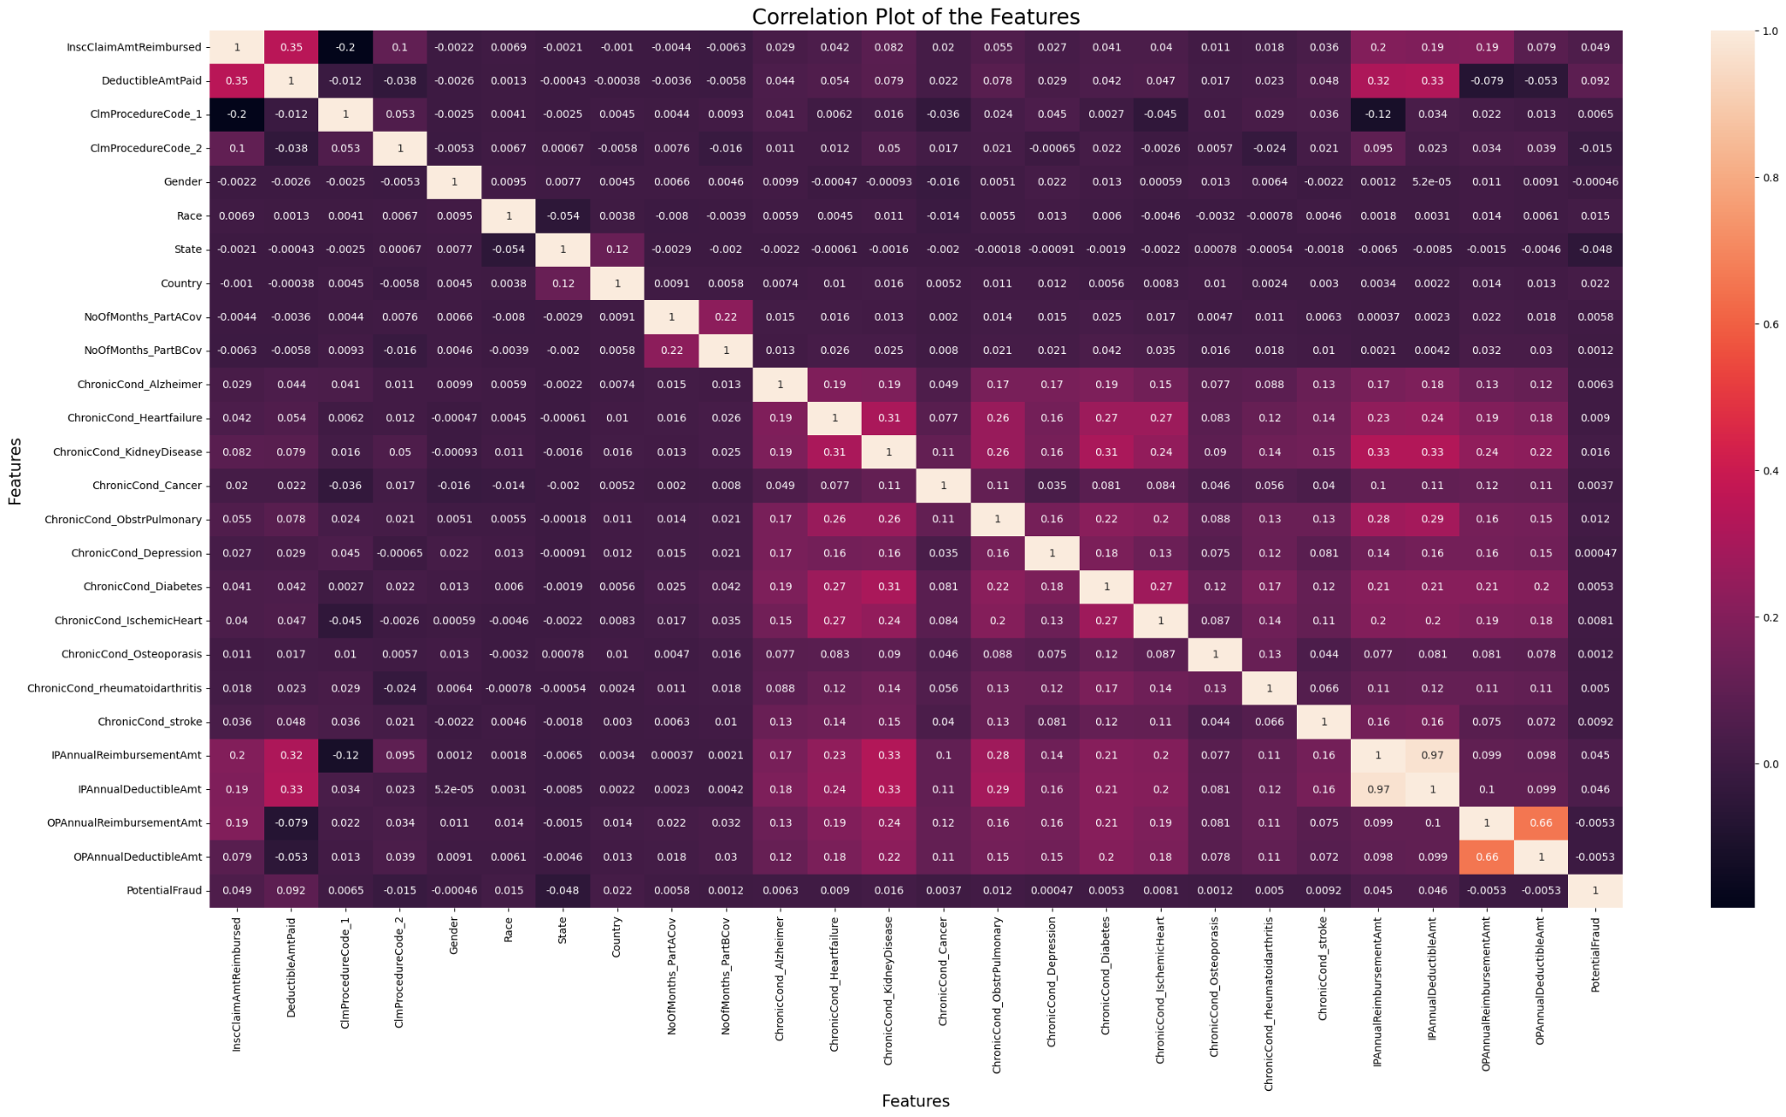
Spearman's rank correlation coefficient

Slide 32
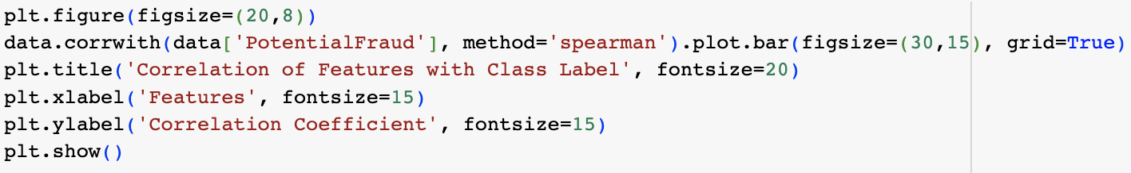

Slide 33
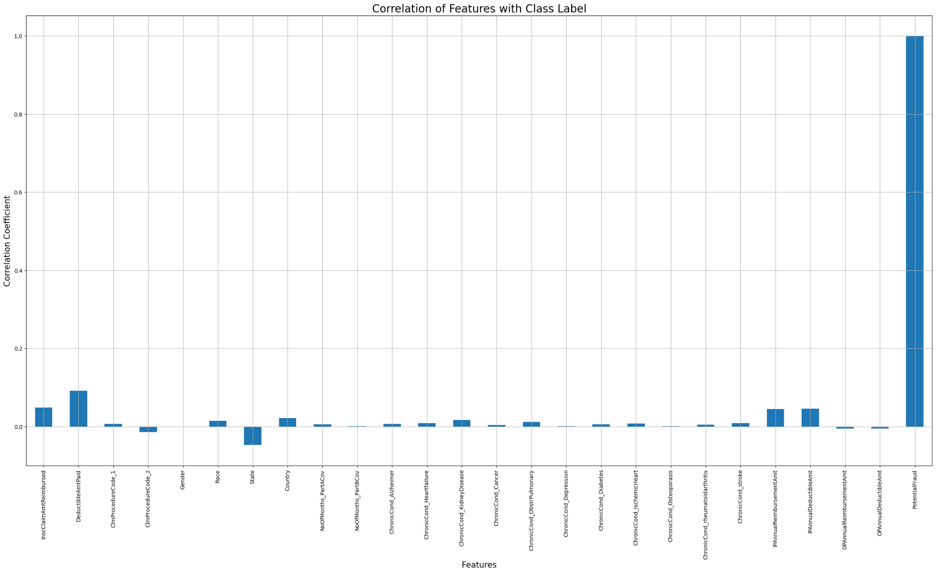
Spearman's rank correlation coefficient

Slide 34
Spearman Correlation Coefficient
IP Annual Reimbursement Amount\t and IP Annual Deductible Amount (0.97) and OP Annual Reimbursement Amount and OP Annual Deductible Amount (0.66) are the highly correlated features and can be used to find the total claim amount.
When plotted against the class label, 'Gender', 'NoOfMonths_PartACov', 'ChronicCond_Depression', 'ChronicCond_Osteoporasis' and 'OPAnnualReimbursementAmt' are found to be very less correlated. But removal shouldn’t be done because a combination of these features might prove useful.

Slide 35
Thank You

